Slide 1
Revenue Management with Hotel Booking Cancellation Predictions using a Machine Learning Classification Model
Phillip Cohen and Chloe Ling
Notes:
Phil

Slide 2
Problem
Question
Hotels accept bookings in advance
However, this places a risks on hotels, which have to guarantee rooms to customers who honor their booking but also bear the cost of vacant rooms when a booking is cancelled or a customer does not show up
Booking cancellations negatively contribute to hotel revenue and accurate forecasts
Can we predict the likelihood of a booking being cancelled using data on previous bookings and outcome?
Expected outcome: 2 columns → Hotel Name and Booking Possibility (0 or 1)
Notes:
Phil
Booking cancellations negatively contribute to hotel revenue and accurate forecasts
Revenue management = “application of information systems and pricing strategies to allocate the right room for the right guest and the right price at the right time via the right distribution channel (Mehrotra and Ruttley, 2006)
Hotels accept bookings in advance
Booking = contract between the customer and hotel, which gives the customer the right to use the service in the future at a settled price, option to cancel the contract prior to the service provision is included
However, this places a risks on hotels, which have to guarantee rooms to customers who honor their booking but also bear the cost of vacant rooms when a booking is cancelled or a customer does not show up
Cancellations = have significant impact on demand-management decisions in the context of revenue management
Current forecasts are important tools for revenue management, but these forecasts are also affected by cancellations (Talluri and Van Ryzin, 2005)

Slide 3
The Dataset
This data is originally from the article Hotel Booking Demand Datasets, written by Nuno Antonio, Ana Almeida, and Luis Nunes for Data in Brief, Volume 22, February 2019.
Data was acquired from hotel’s Property Management System (PMS) SQL databases
Dataset can be subdivided into booking information for a city hotel and a resort hotel
119390 Observations
'hotel', 'is_canceled', 'lead_time', 'arrival_date_year', 'arrival_date_month', 'arrival_date_week_number', 'arrival_date_day_of_month', 'stays_in_weekend_nights', 'stays_in_week_nights', 'adults', 'children', 'babies', 'meal', 'market_segment', 'distribution_channel', 'is_repeated_guest', 'previous_cancellations', 'previous_bookings_not_canceled', 'reserved_room_type', 'assigned_room_type', 'booking_changes', 'deposit_type', 'days_in_waiting_list', 'customer_type', 'adr', 'required_car_parking_spaces', 'total_of_special_requests', 'reservation_status'
Notes:
Chloe

Slide 4
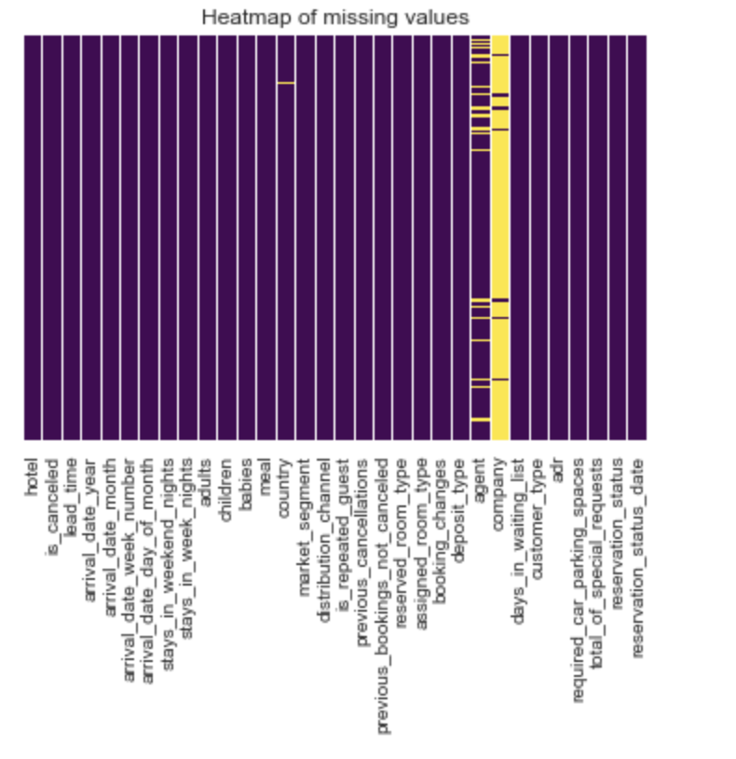
Preprocessing
Convert nominal and ordinal variables to integers
Remove features with > 10% null observations
Remove observations with null values in any features
Z-Scale data
Notes:
Chloe

Slide 5
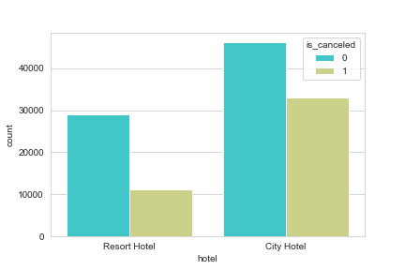
Visualization on Cancellation in Hotel vs. Resort
Notes:
Chloe

Slide 6
Model Design
Model | Model Type | Hyper Parameters | Selection Method
Logistic Regression | Regresion | Maximum iterations = 10000 | 10 fold cross validation
Random Forest | Tree-Based | n_estimators = 100, criterion = “entropy” | minimize cross validation loss metrics by random search
XG Boost | Ensemble | Learning rate = 0.300 Max Depth = 6 | Minimize cross validation loss metrics by random search
kNN | Lazy-Learning | K = 2 | Minimize error rate of ks from 1 to 40
Ensemble classifier | Ensemble | Voting method = majority | --
Notes:
Chloe

Slide 7
Feature Importance by Permutation Importance
Model Type | Feature 1 | Feature 2 | Feature 3
Logistic Regression | Arrival Date Week Number | Arrival Date Month | Deposit Type
Random Forest | Total Special Requests | Deposit Type | Lead Time
KNN | Lead Time | Average Daily Rate | Arrival Date Week Number
XGBoost | Deposit Type | Total Special Requests | Market Segment
Ensemble | Deposit Type | Lead Time | Average Daily Rate
Notes:
Phil
Deposit Type: No Deposit – no deposit was made; Non Refund – a deposit was made in the value of the total stay cost; Refundable – a deposit was made with a value under the total cost of stay.

Slide 8
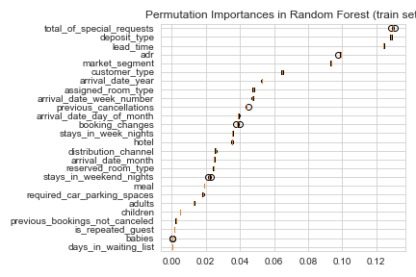
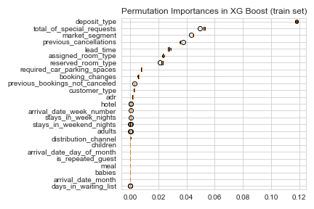
Feature Importance
Notes:
Phil
Deposit Type: No Deposit – no deposit was made; Non Refund – a deposit was made in the value of the total stay cost; Refundable – a deposit was made with a value under the total cost of stay.

Slide 9
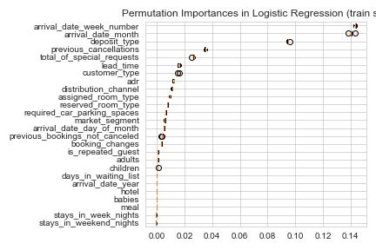
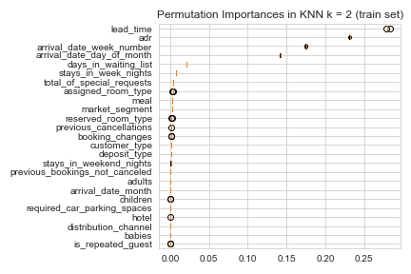
Feature Importance
Notes:
Phil
Deposit Type: No Deposit – no deposit was made; Non Refund – a deposit was made in the value of the total stay cost; Refundable – a deposit was made with a value under the total cost of stay.

Slide 10
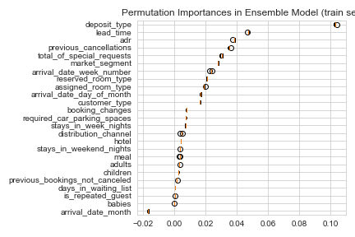
Feature Importance
Notes:
Deposit Type: No Deposit – no deposit was made; Non Refund – a deposit was made in the value of the total stay cost; Refundable – a deposit was made with a value under the total cost of stay.

Slide 11
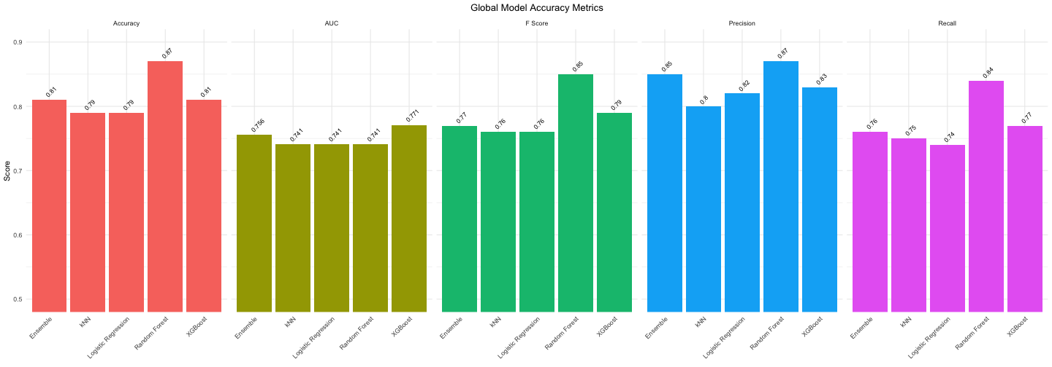
Performance Metrics (Global)
Notes:
Phil

Slide 12
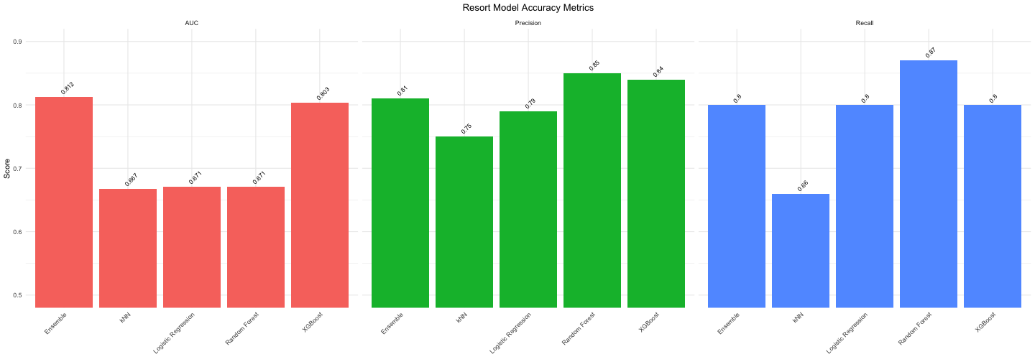
Performance Metrics (Resort)
Notes:
Chloe

Slide 13
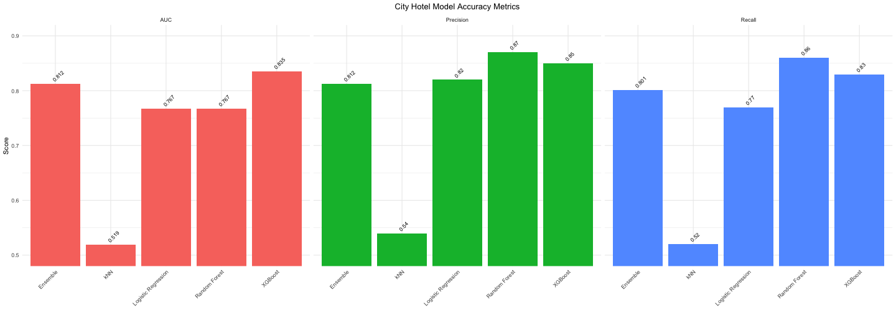
Performance Metrics (City)
Notes:
Chloe

Slide 14
Conclusions
Cancellation of hotel bookings can be predicted with over 80% precision
Ensemble methods outperform other methods for modelling hotel cancellations
The most important features of these models include deposit type, lead time to booking, average daily rate, and arrival date
An ensemble model combining kNN, logistic regression, random forest, and XG Boost stratified by resort or city hotel performs optimally
Notes:
Phil

Slide 15
Thank you!
Notes:
Chloe

